Slide 1
Bank Loan Case Study

Slide 2
Project description: This case study attempts to demonstrate the application of EDA in a real-world business environment. In this case study, in addition to using the techniques learned in the EDA module, you will gain a basic grasp of risk analytics in banking and financial services, as well as how data is utilized to reduce the risk of losing money when lending to consumers.
Approach: This case study has two enormous data sets: the current application and the previous application. Each included several unneeded columns that would be useless for risk assessments, as well as many blank data. I started by cleaning. To evaluate this enormous set of data, I first cleaned the data, located some outliers and deleted them, and then began performing univariate and bivariate analysis using pivot tables and charts.
Tech used: power bi,python

Slide 3
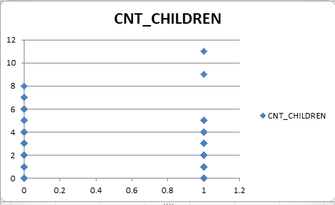
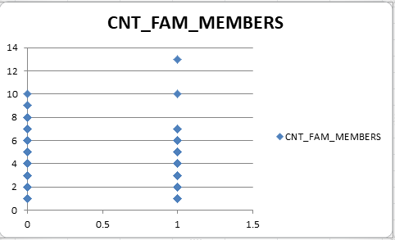
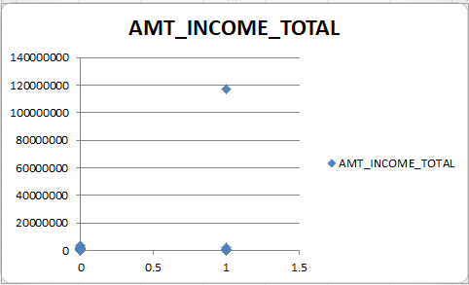
Outliers

Slide 4
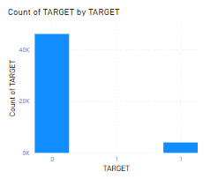
Data imbalance

Slide 5
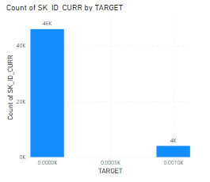
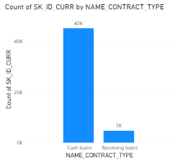
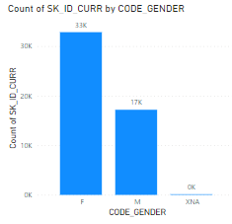
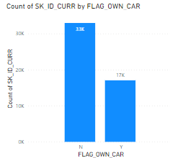
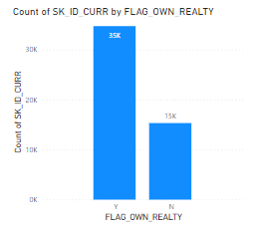
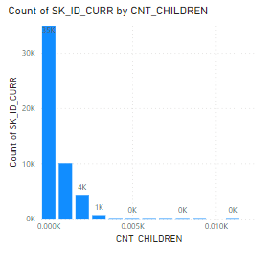
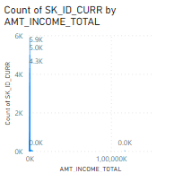
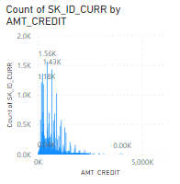
Task 1
UNIVARIATE Analysis

Slide 6
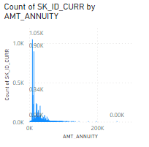
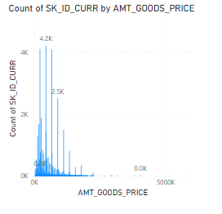
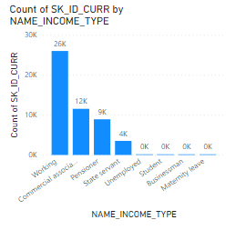
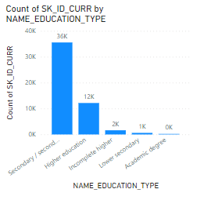
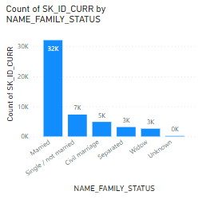
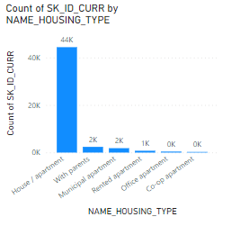
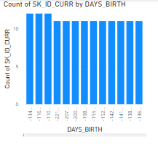
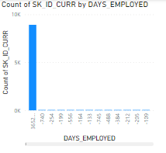

Slide 7
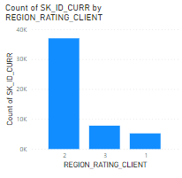
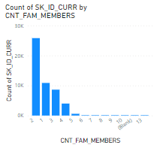
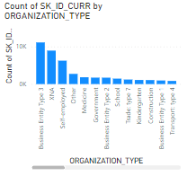

Slide 8
Inference
91.93% of the applications belong to other cases. Only 8.07% of clients have difficulty in
payment.
90.48% of the clients apply for cash loans and only 9.52% apply for revolving loans.
65.83% of clients are female and 34.16% are male.
65.99% of the clients do not own a car.
69.37% of clients own realty.
70.04% of clients do not have any children, 19.88% have one child and 8.70% have two children.
About 99.14% of the clients lies in the salary bracket of Rs.25000 to Rs.5,25,000.
85.86% of the application on have credit amount between Rs.45,000 to Rs.10,45,000 and
13.67% have credit amount between Rs.10,45,000 to Rs.20,45,000.
55.61% of loan annuity is between Rs.1,500 to Rs.26,500 ; 38.16% between Rs.26,500 to Rs.51500 and 5.63% between Rs.51,500 to Rs.76,500.
89.32% of the goods’ price range between Rs.40,000 to Rs.10,40,000 and 10.27% between Rs.10,40,000 to Rs.20,40,000.

Slide 9
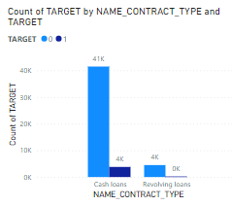
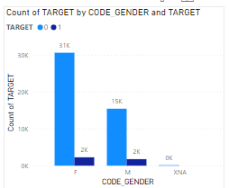
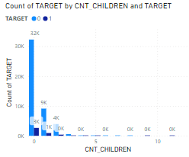
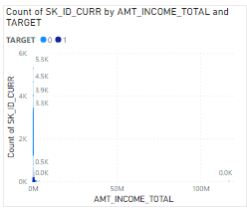
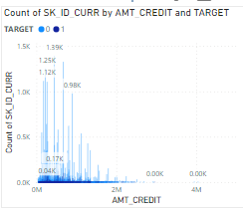
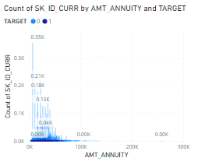
Bivariate Analysis

Slide 10
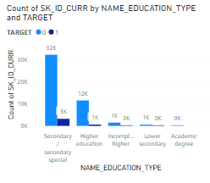
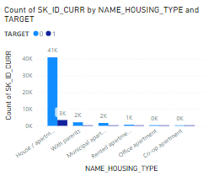
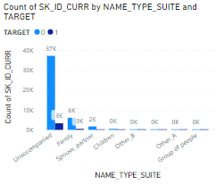
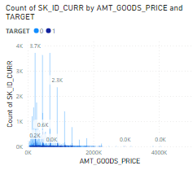
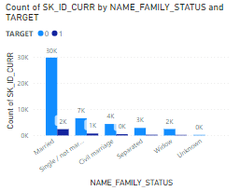
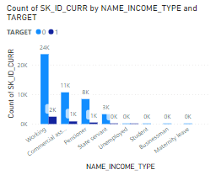

Slide 11
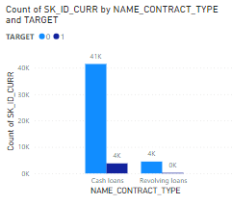
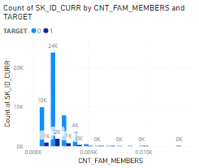
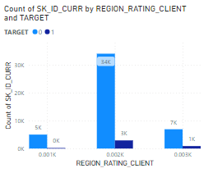
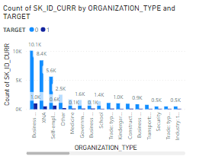

Slide 12
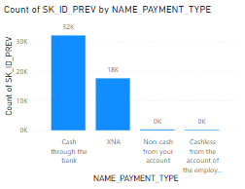
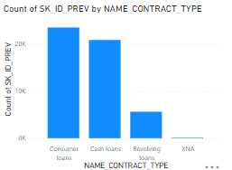
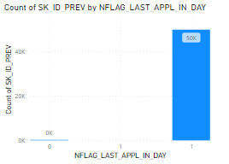
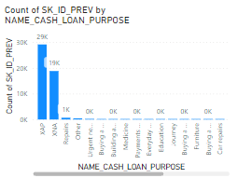
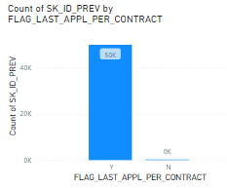
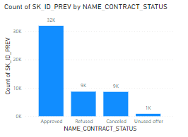
Univariate of previous data

Slide 13
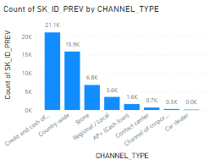
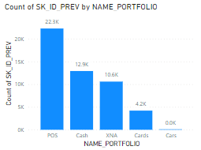
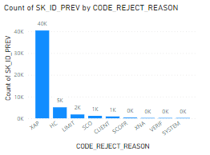
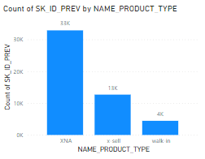
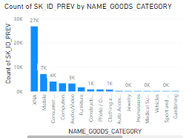


Slide 14




Slide 15






Bivariate for previous data

Slide 16







Slide 17

Correlation

Slide 18
Hyperlinks
Correlation plot: https://colab.research.google.com/drive/1_PUmAyw5-IMfOB0TWMpXydySoX_1NEgG#scrollTo=dyScE75yLvO6&uniqifier=1
Excel sheet: https://docs.google.com/spreadsheets/d/1h8NQNBiRTFU-0fQ7PnBxusV9UTgGk3cy/edit?usp=sharing&ouid=109330305611183196317&rtpof=true&sd=true

